Slide 1
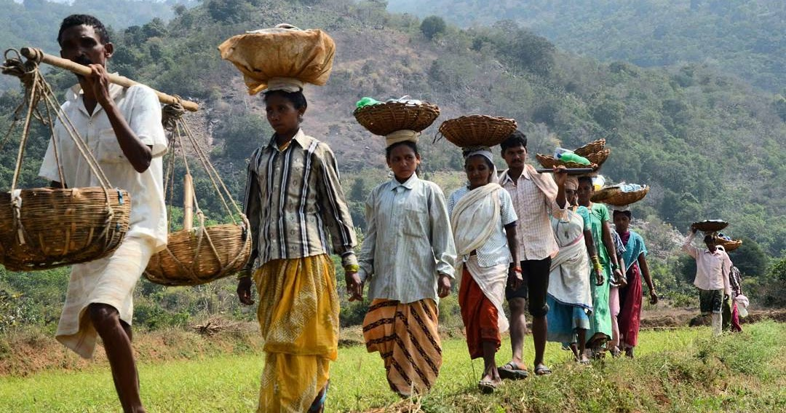

NREGA ANALYSIS USING POWER BI
By Gaurav Kashyap

Slide 2


Overview
The National Rural Employment Guarantee Act (NREGA) is a pivotal initiative aimed at enhancing livelihood security in rural areas by providing at least 100 days of wage employment in a financial year to every household whose adult members volunteer to do unskilled manual work. This analysis seeks to evaluate the effectiveness, regional disparities, budget utilization, key factors, and policy optimization of the NREGA scheme using data-driven insights.

Slide 3


Table Of Contents
Introduction
Problem Statement
Dataset Overview
Dataset Explanation
Data Analysis Using Power BI
Insights Keywords

Slide 4
Introduction
NREGA plays a crucial role in providing a safety net for the rural poor, promoting inclusive growth, and creating sustainable assets in rural areas. The scheme's scope encompasses a wide range of public works, including water conservation, afforestation, and rural infrastructure development.
Purpose of the Analysis
This analysis seeks to evaluate the effectiveness and impact of the NREGA scheme by addressing several key questions and challenges:
Effectiveness in Employment Generation
Regional Disparities
Budget Utilization
Key Factors and Roadblocks
Policy Optimization

Slide 5
Problem Statement
NREGA is a vital initiative to alleviate rural unemployment and poverty. This project seeks to address several key questions and challenges associated with NREGA:
How effective is NREGA in providing employment opportunities to rural households?
Are there regional disparities in the implementation and outcomes of the scheme?
What is the utilization of the allocated budget, and how does it correlate with employment generation?
What are the key factors contributing to the completion of NREGA works, and are there any roadblocks to its success?
Can data-driven insights guide policymakers and administrators in optimizing the scheme's impact?

Slide 6
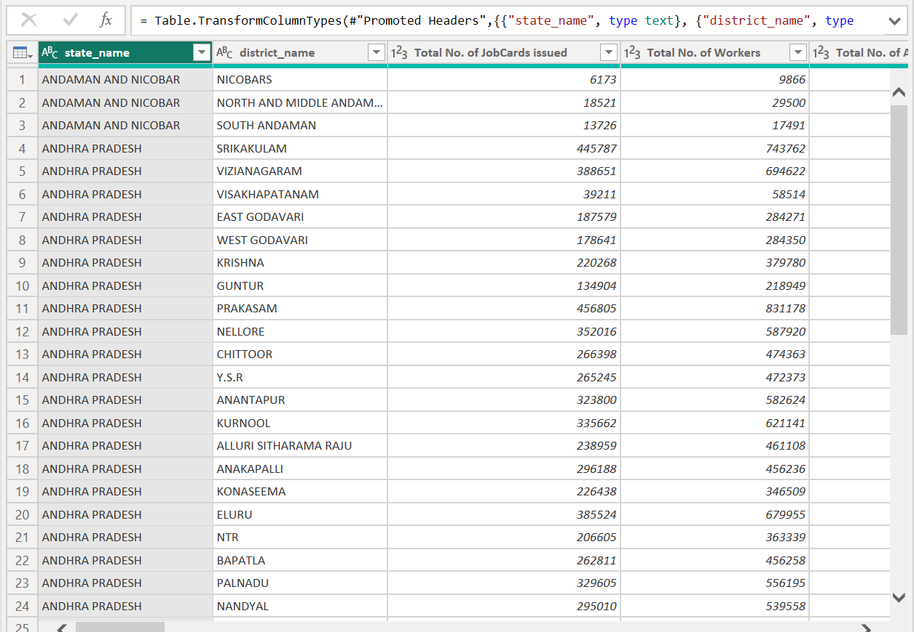
Dataset Overview

Slide 7
Dataset Explanation
The dataset used for this analysis is sourced from official government records and contains information related to NREGA implementation across various states and districts in India. It comprises 28 columns, encompassing data on job cards, worker details, budget allocation, work completion statistics, expenditure, and more. This dataset offers a comprehensive view of the progress and challenges faced by the NREGA program.

Slide 8
Data Analysis
Using
Power BI

Slide 9
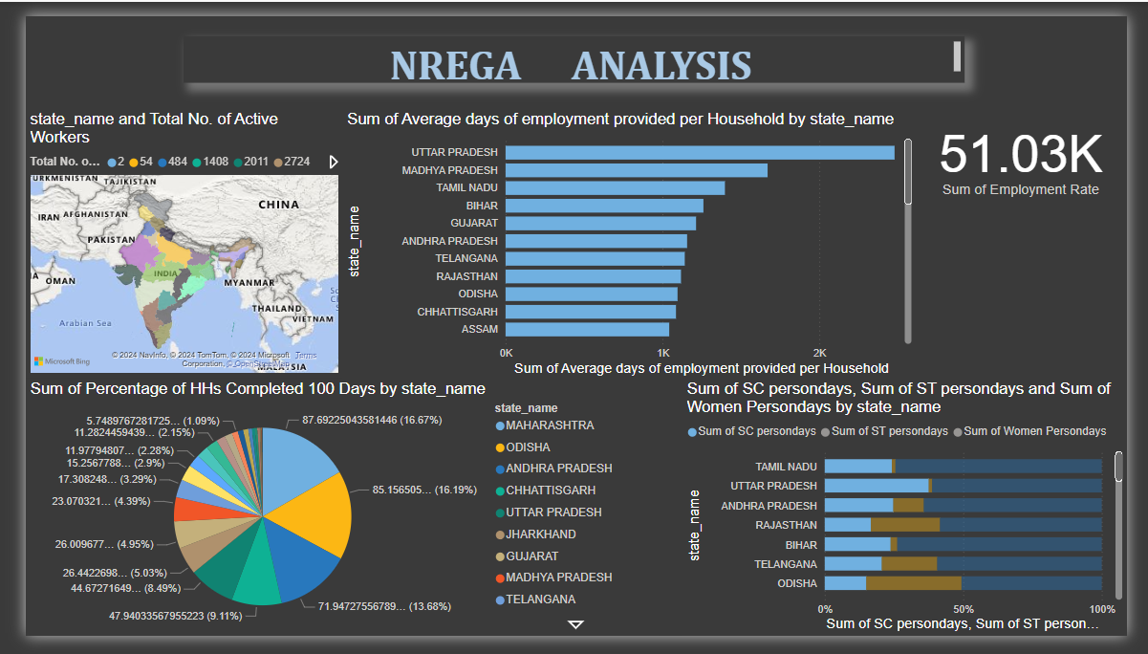
1. How effective is NREGA in providing employment opportunities to rural households?

Slide 10
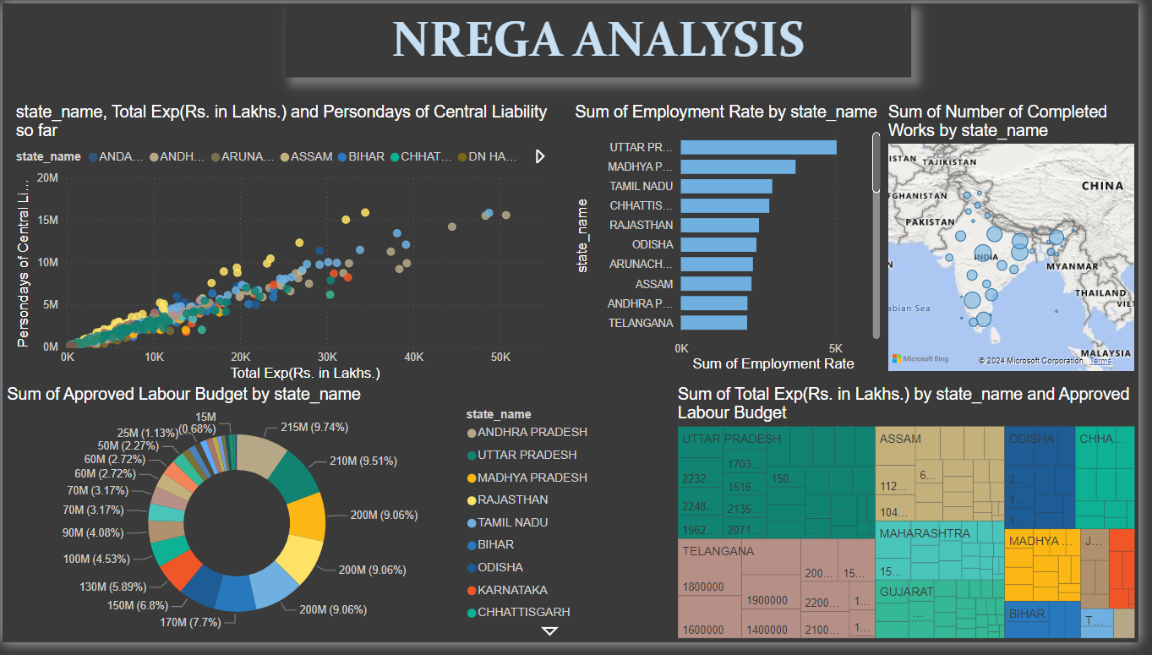
2.Are there regional disparities in the implementation and outcomes of the scheme?

Slide 11
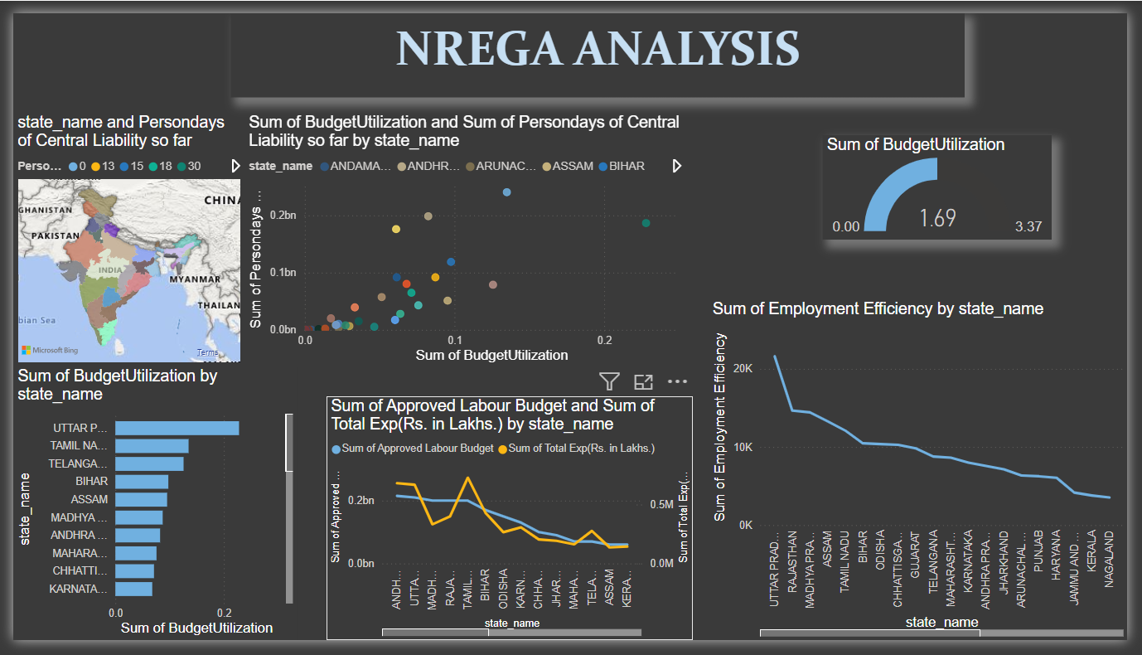
3.What is the utilization of the allocated budget, and how does it correlate with employment generation?

Slide 12
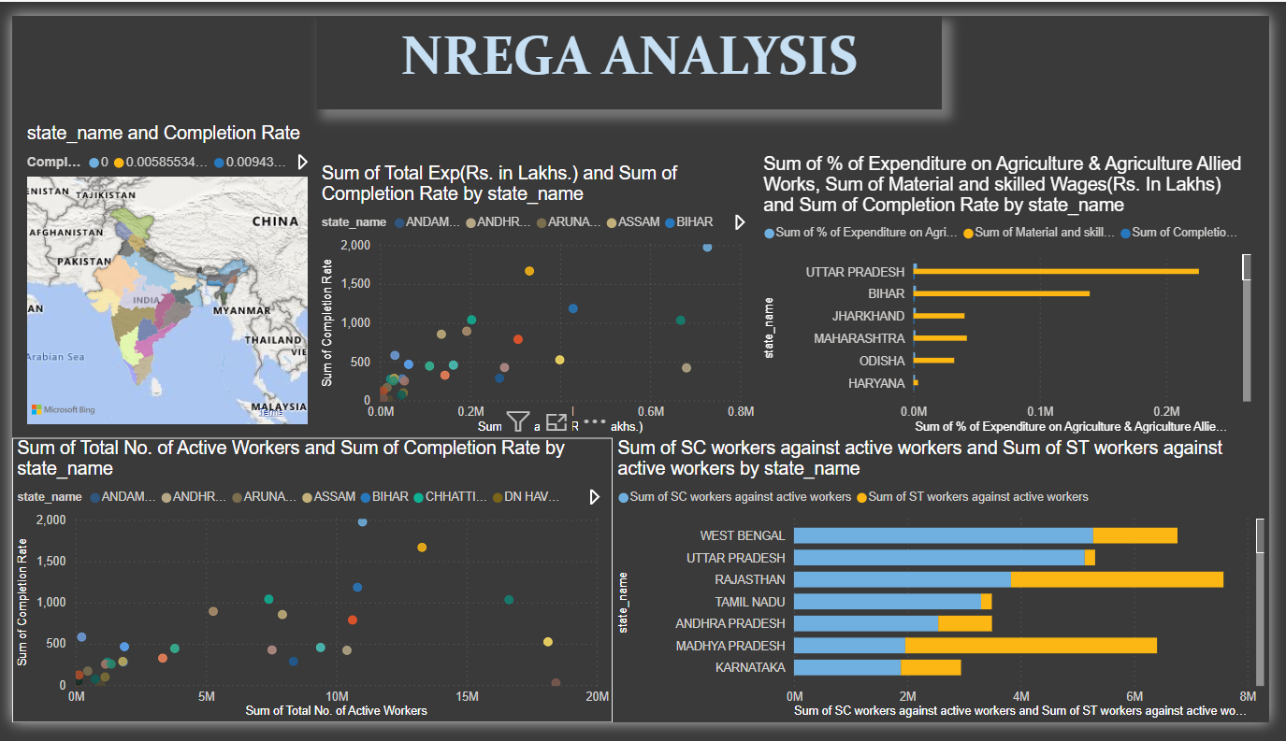
4.What are the key factors contributing to the completion of NREGA works, and are there any roadblocks to its success?

Slide 13
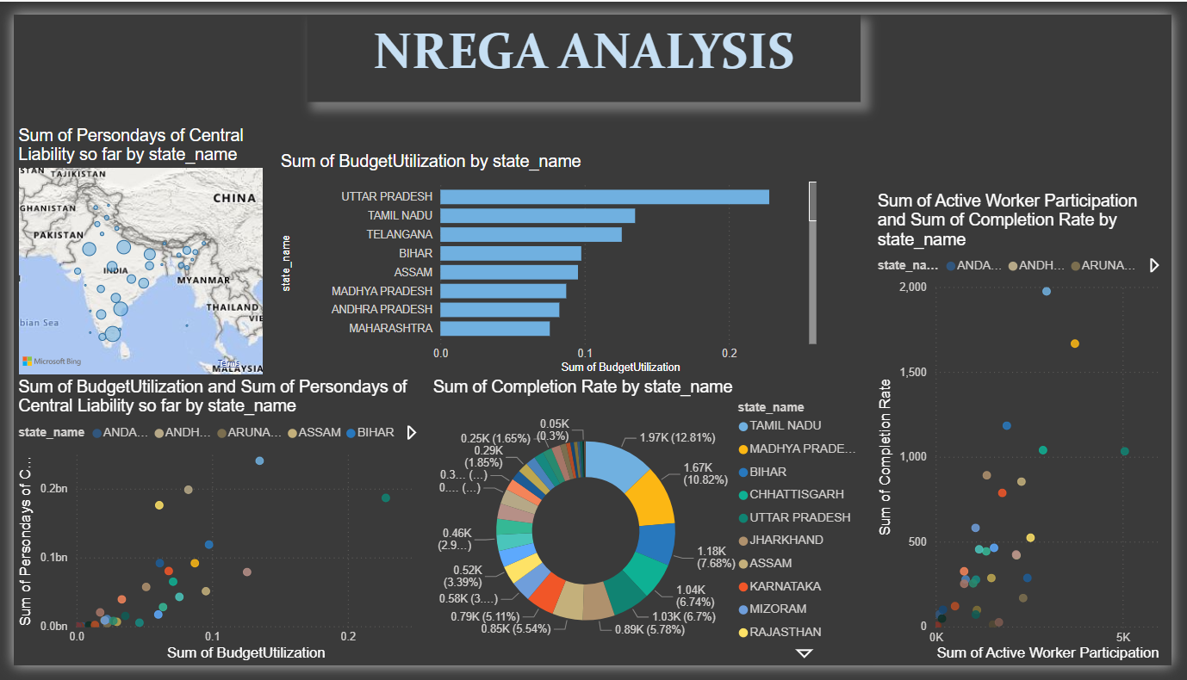
5.Can data-driven insights guide policymakers and administrators in optimizing the scheme's impact?

Slide 14

Insights Keywords
By leveraging the analysis of NREGA data, stakeholders can significantly enhance the effectiveness, transparency, and impact of the scheme. The insights derived from the analysis enable better decision-making, targeted interventions, and optimized resource utilization, ultimately contributing to the alleviation of rural poverty and unemployment.

Slide 15

Thank
you!

